Slide 1


Banking Marketing Targets
By Jump-start

Slide 2


Our Data Scientist Team
Maghfira Amalia
Mahendra Prabaswara
Ridwan Donovan
Windy Nurfikri
Your logo
1

Slide 3

Banking Marketing Targets
Term deposits are one of the major income sources of a bank. These days, selling deposits through telemarketing is still the main of various plans to reach out to the clients. However, the bank still needs to pay attention to the effectiveness of the direct campaign considering the high cost and the time it takes. Based on previous campaign data of 45,211 clients, only 3.3% of them actually subscribed to a term deposit. Despite the fact that 36,959 clients were never contacted. Therefore, determining the right potential depositors needs to be done to save resources. Meanwhile, we also need to review the efficiency and effectiveness of telemarketing as a direct campaign method.
45,211
CLIENTS
3.3%
SUBSCRIBED
36,959
NEVER CONTACTED
Your logo
2

Slide 4

Goal
Increase the efficiency and effectiveness of direct campaign
Objectives
Predict the potential depositor by classifying them (based on their background and financial history)
Find out the success rate of telemarketing as direct campaign method
Business Metric
Conversion Rate
Your logo
3

Slide 5

Data Preprocessing

Slide 6



Customer Profile
Feature
Age
Job
Marital Status
Education
Default
Balance
Housing
Loan
Contact
Day
Month
Duration
Campaign
pdays
Previous
poutcome
Target
Depositor
Business Metrics
Conversion Rate

Slide 7
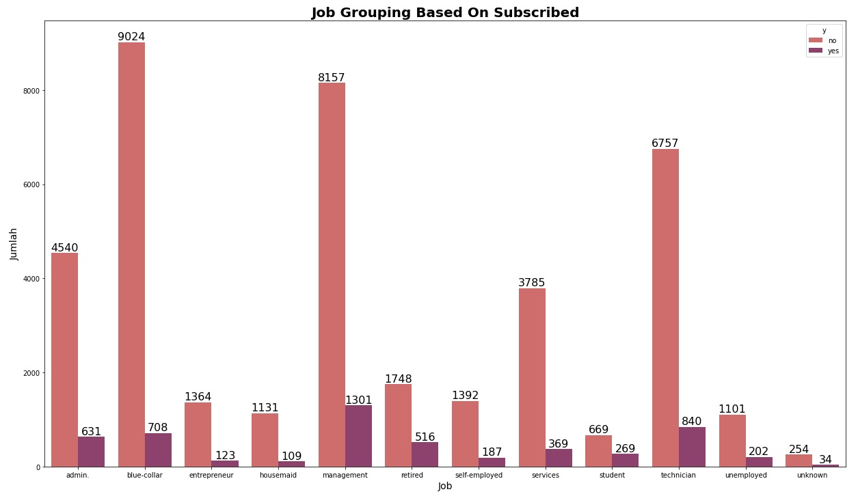
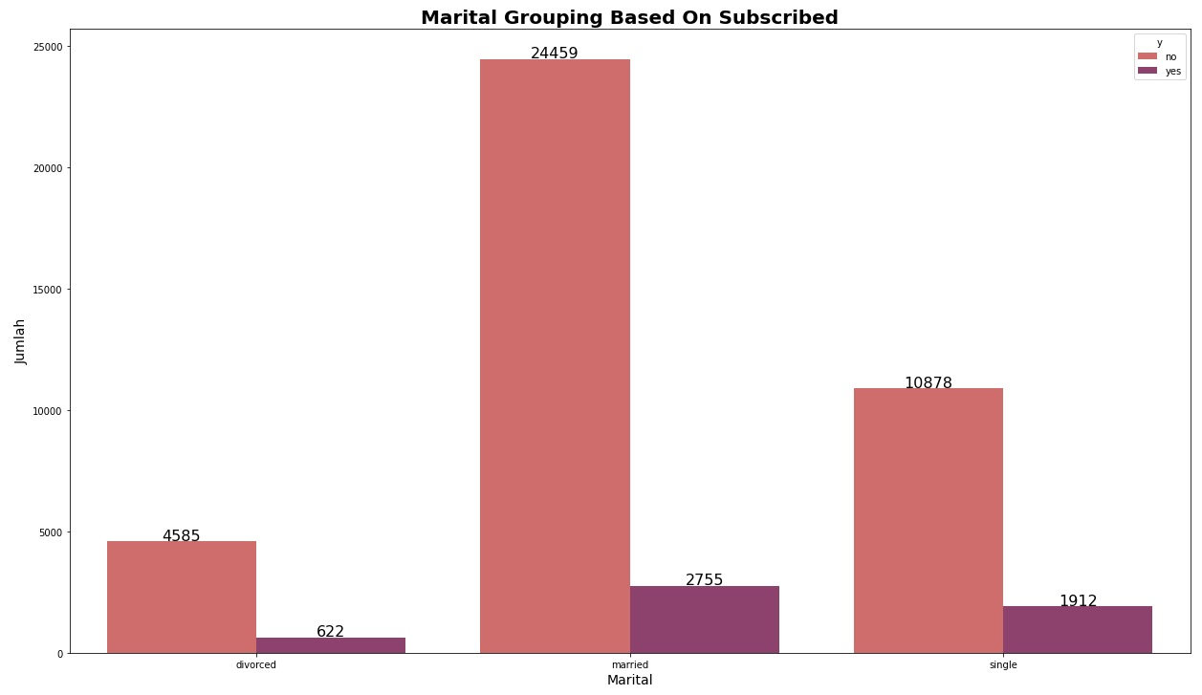
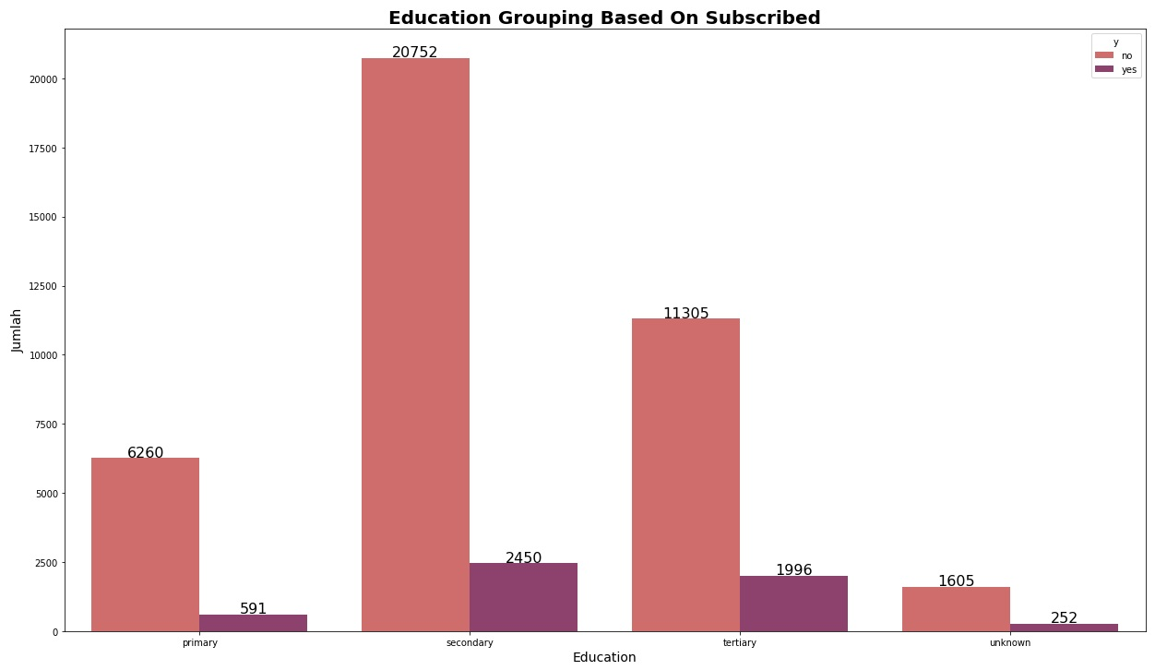
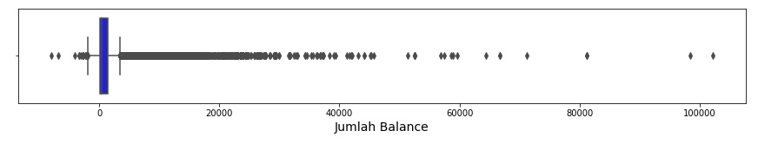
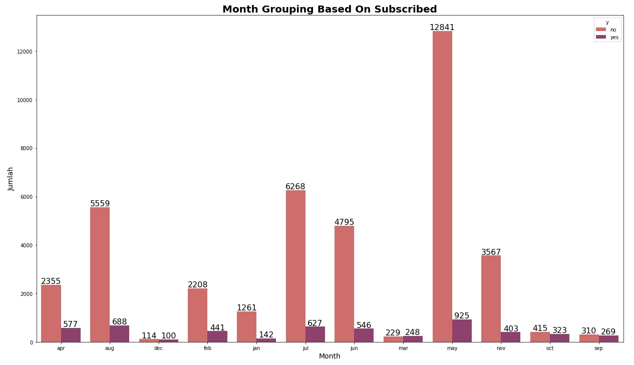
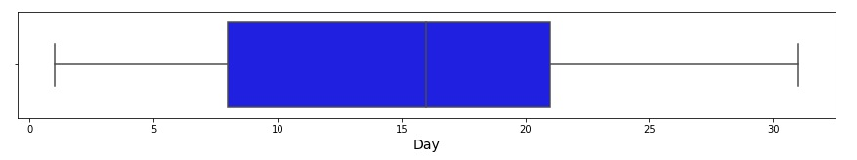
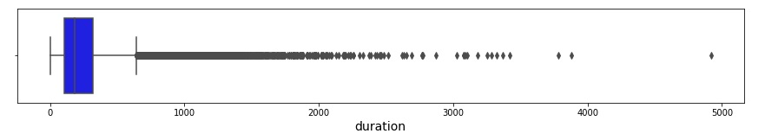
Attribute Exploration

Slide 8
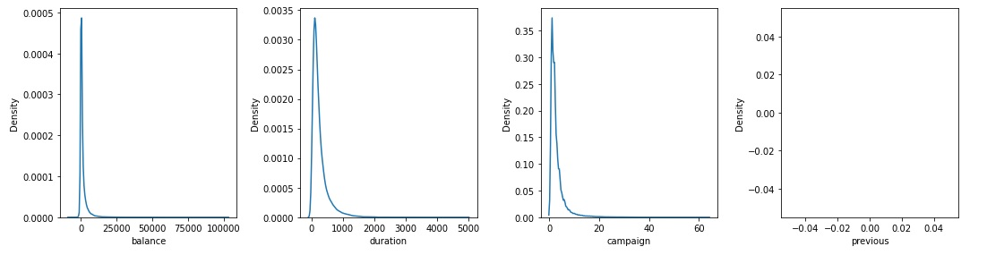
Feature Transformation

Slide 9
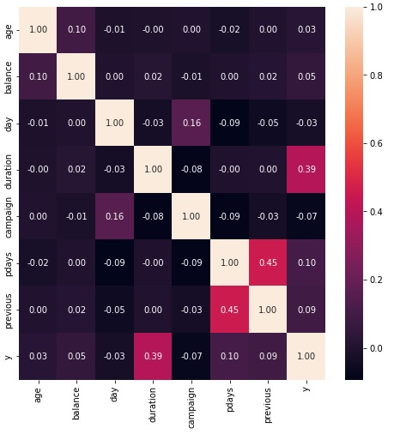
Feature Correlation

Slide 10
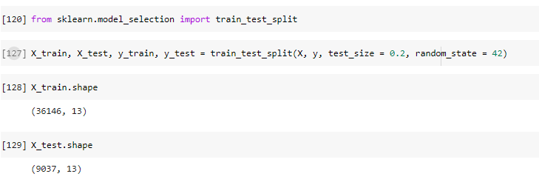
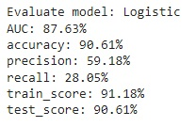
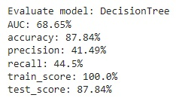
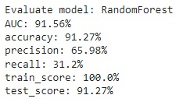
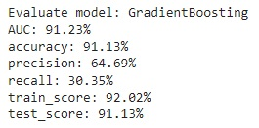
Split to Train & Test Dataset
Ratio Train & Test Dataset 80 % : 20 % ( 36142 : 9037 )
Model Experiment
Find The Best Model

Slide 11
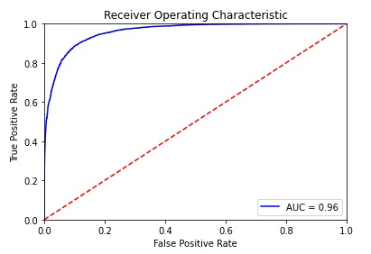
Model Evaluation

Slide 12
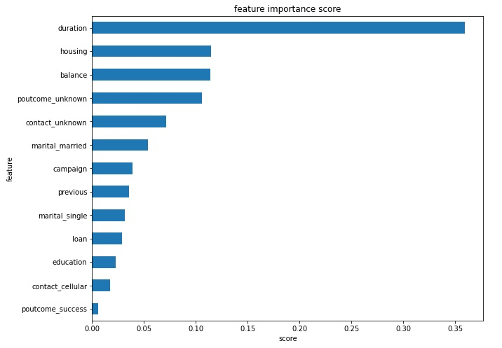
Feature Importance

